Slide 1
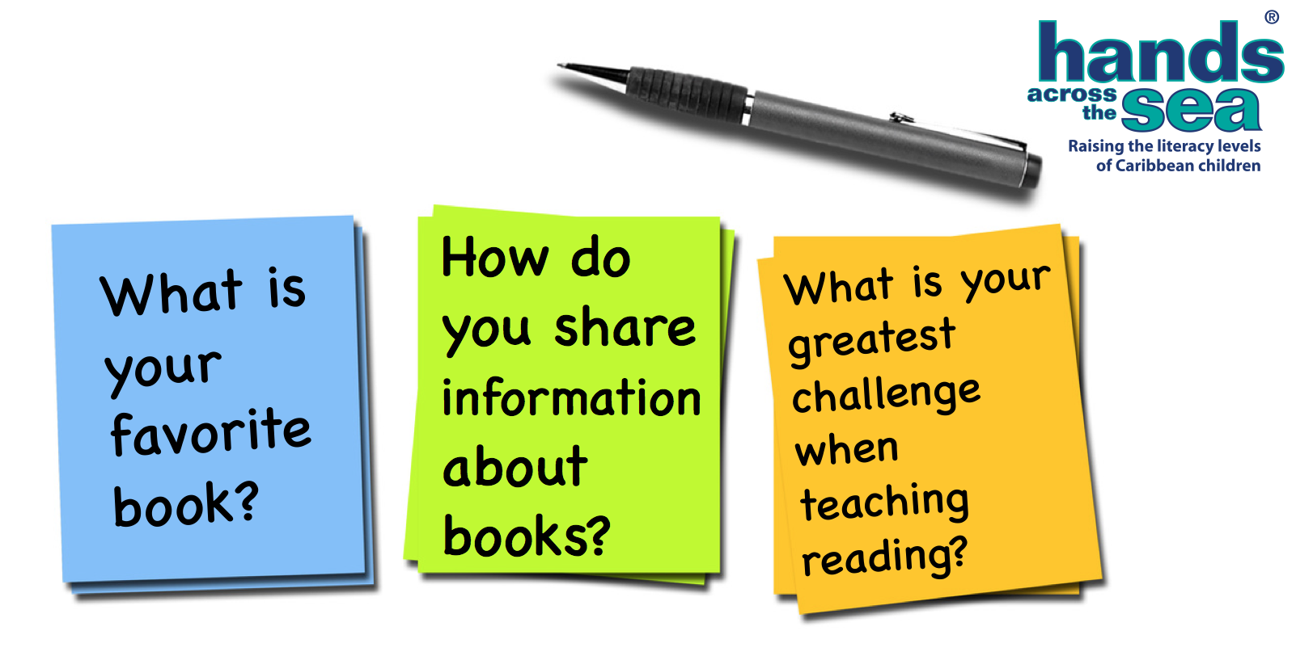
Sticky Note Activity and Intro
Notes:
This sticky note activity is one of my favorite ways to open a Teacher’s Resource Guide to the Library workshop.

Slide 2
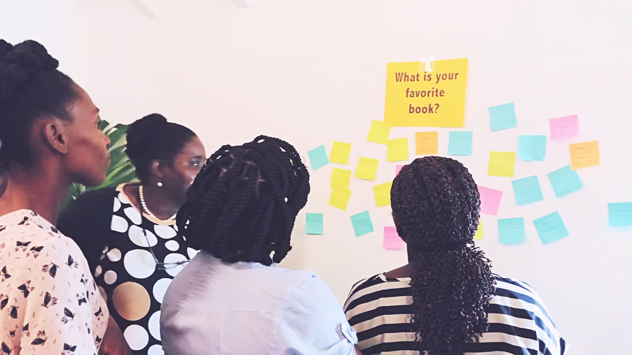
Write your responses.
Post your responses.
Read your colleagues responses.
Be prepared to share what your colleagues wrote.
How do you share information about books?
What is your favorite book?
What is your greatest challenge when teaching reading?
Notes:
This sticky note activity is one that can be used with teachers for three purposes.
*One to see ourselves not just as teachers but as readers (many for the first time).
*Two to brainstorm ways to connect teachers to how people naturally share information about books and get them thinking about those ways we can do something similar in our classrooms through routines, activities, and opportunities.
*Third to provide teachers with an opportunity to put into words some of the challenges they have faced in regards to teaching reading. Once teachers read what their colleagues have written, many of us are in some ways relieved that we are not the only ones experiencing these things. There is a sense of comradery there. And together we can collaborate ways to address those specific challenges. It also provides a chance for teachers to explain what they are hoping to gain from the workshop.
This activity has been adapted from educator and librarian, Jennifer Thrift, who facilitated several sessions at Hands Across the Sea’s St. Kitts workshop in 2018.
Take a few moments now to write responses on each of the three sticky notes that were handed out. Colors don’t matter. Just think of the first things that come to mind. Jot down a few words (doesn’t have to be a full sentence) and for this activity—don’t write your name. Just keep it anonymous. Once you’ve got your responses to these three questions,
**Get up out of your seat and put the sticky note answer on the wall underneath the specific question displayed around the room. Walk around and read what your colleagues wrote on their sticky notes hung up on the wall. Then sit back down and be ready to share one thing your colleagues wrote for each. We will set the time for about 5-7 minutes so you have a chance to read what your colleagues have written. *Pause the video to come back to it after the 5 to 7 minutes are up.

Slide 3
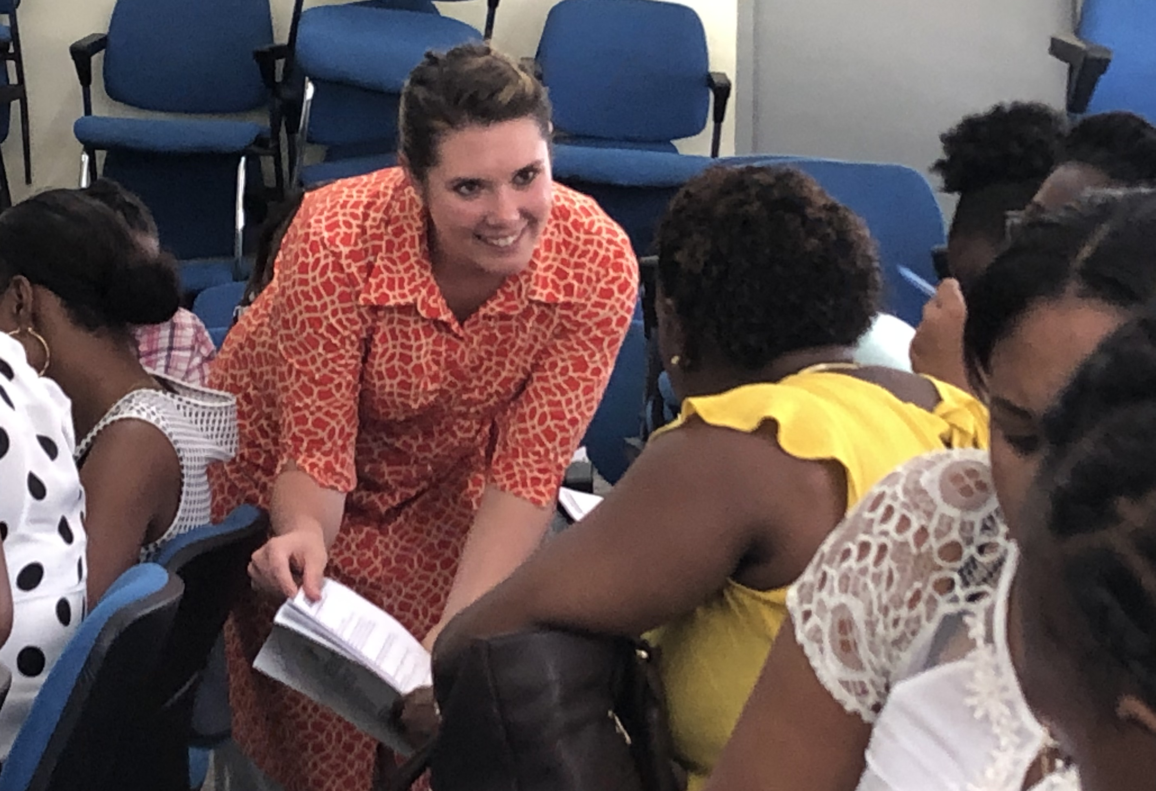
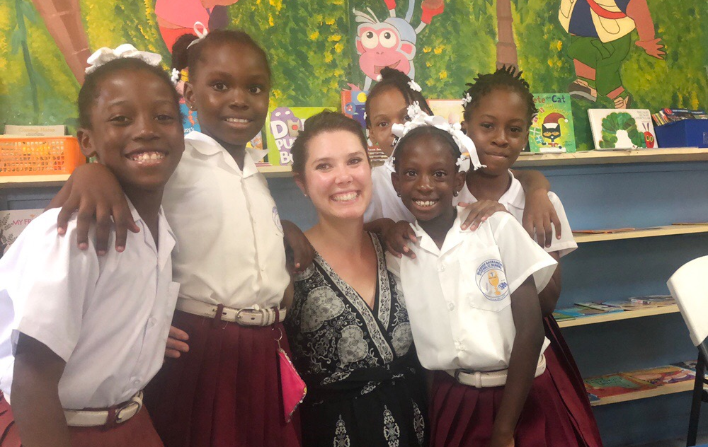
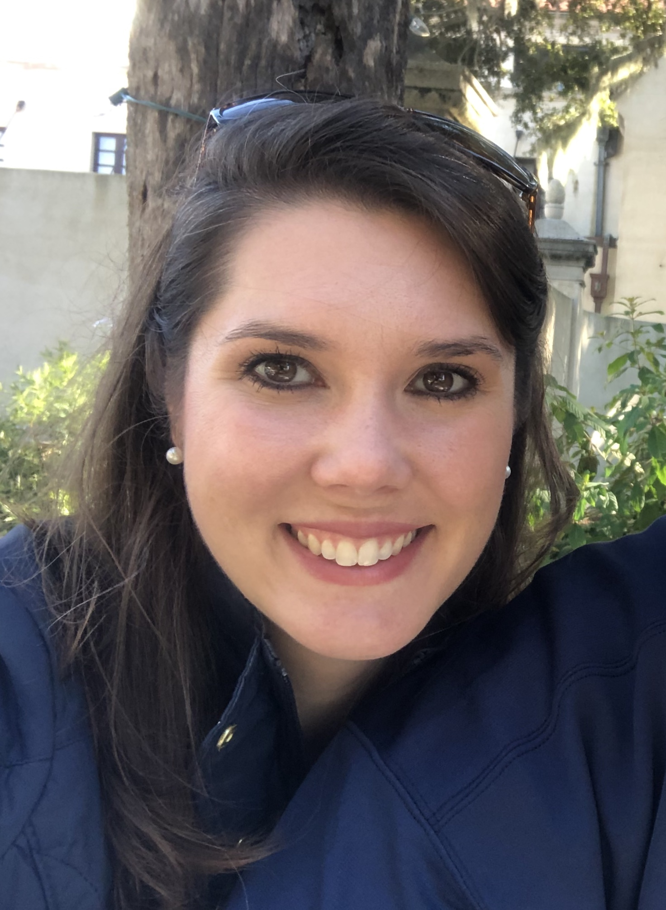
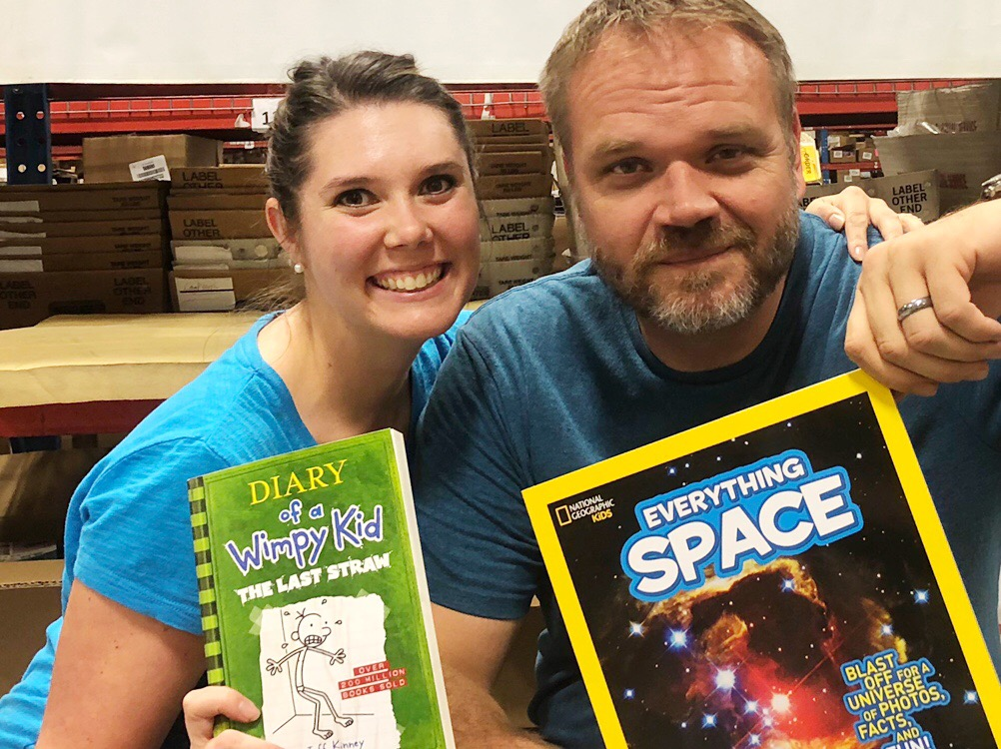
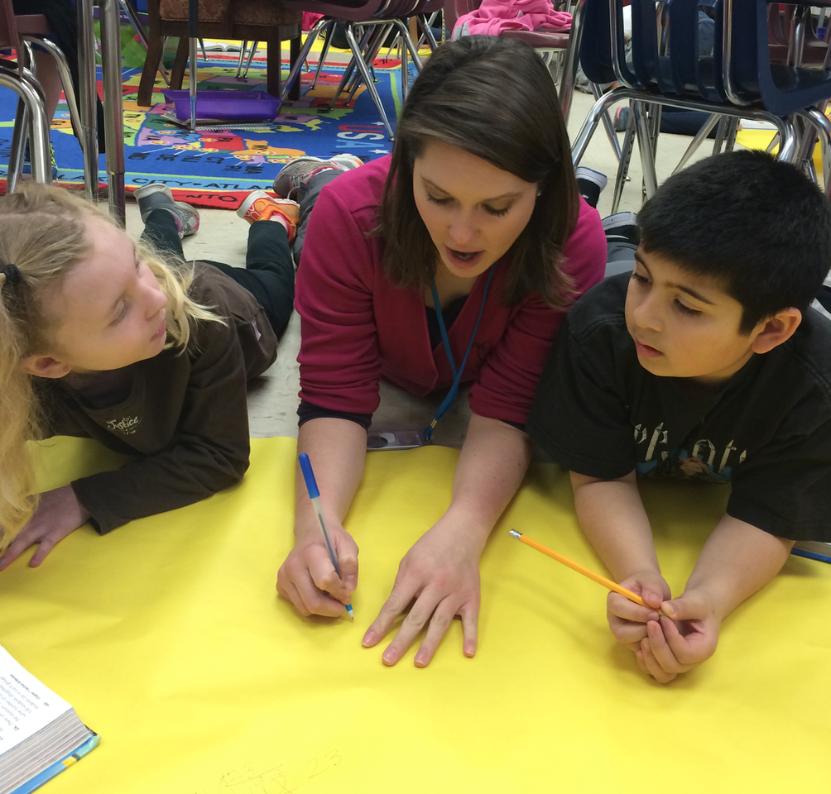
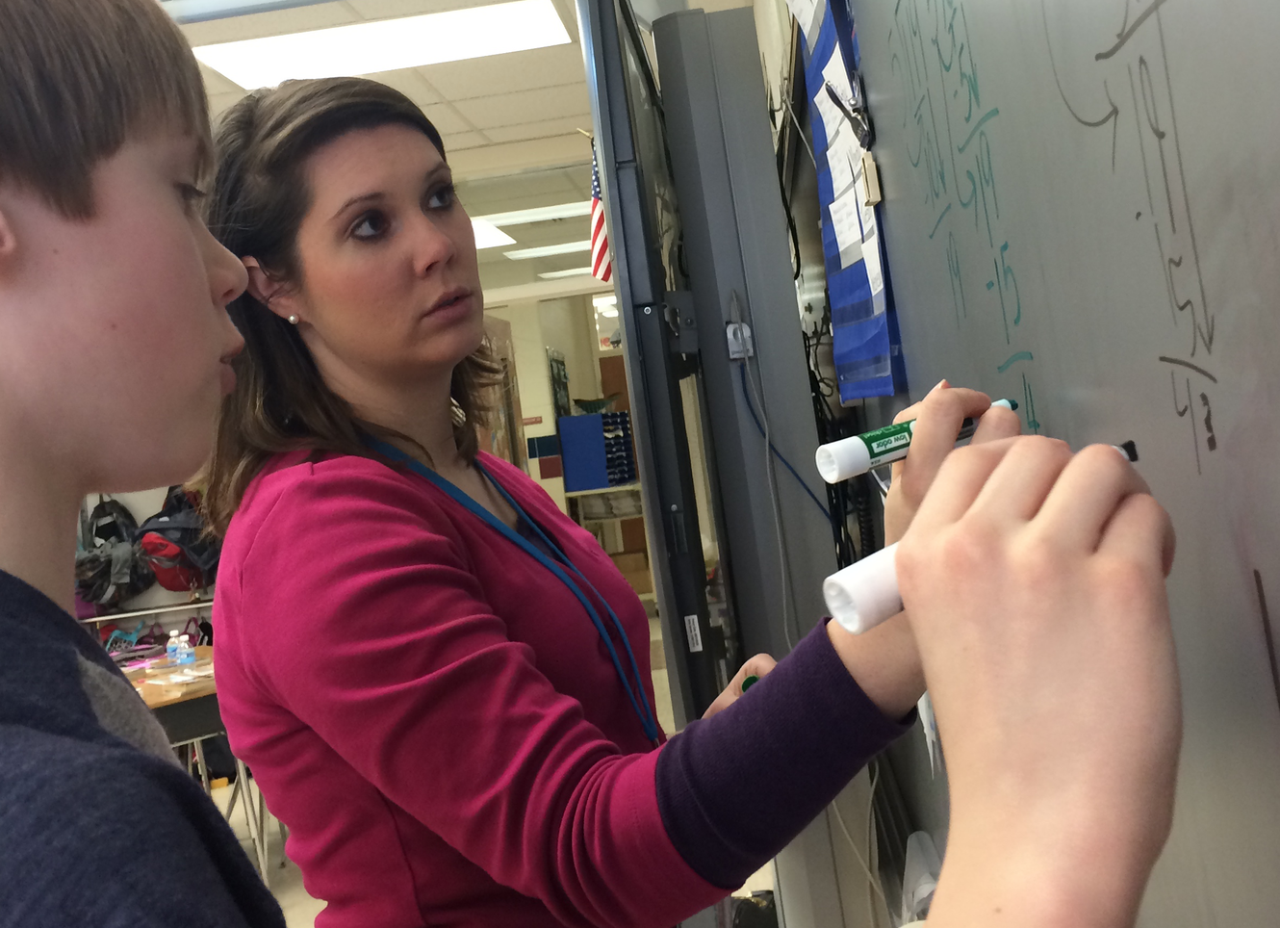

Program Director
hannah@handsacrossthesea.net
Notes:
My name is Hannah Knecht, and I am the Program Director of *Hands Across the Sea. *Hands Across the Sea is a nonprofit organization that for the last thirteen years has developed and sustains hundreds of school libraries to promote literacy among the children in the Caribbean. *I have a Masters Degree in Education and Curriculum Development and have nine years experience as a primary and *secondary school teacher for Grade 4, Grade 6, and (what you would consider) Form 1 in the United States.
*Currently, I manage a team of nine on-island Literacy Links, who come alongside of schools wanting a library program through support and coaching so that books are not only accessible to students and teachers but also that libraries are flourishing in their lending programs, providing action plans and problem-solving solutions to increase borrowing and track progress. A successful library is one that has books being checked out by both teachers and students every single day throughout the course of a school year and increasing over time! *I am married to the love of life, who is currently a Grade 6 teacher, and we live with our cat in Florida.
But I am here for you. *Facilitating teacher workshops and collaborating with our Literacy Links to create meaningful content for you as educators is my goal. My mission is that you can take back something you learned from the workshop and start using it right away with your students. Reach out with any questions through email. My address is hannah@handsacrossthesea.net and *feel free to follow me on Facebook too.

Slide 4
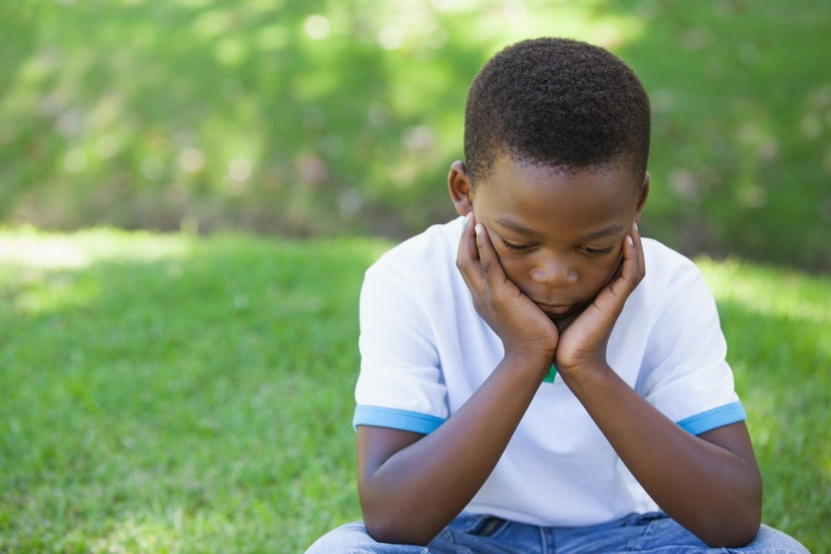
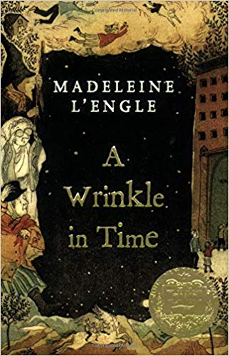
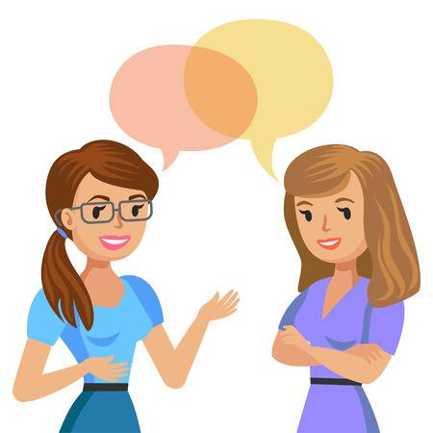
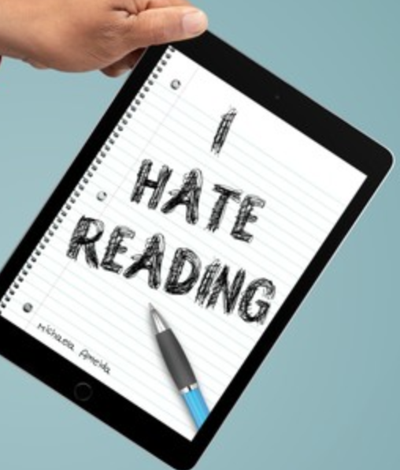
Notes:
*My favorite book is called A Wrinkle in Time, and it’s by Madeleine L’engle. It’s a fictional book geared towards Grade 6 and Form 1, 2, and 3 students that makes us think about time, thought, energy, and the importance of family. Even though I read this book as an adult for the first time, I was so inspired by it—and I love being able to share it with my students.
Do you ever share books that you are reading yourself with your students? How often do you go into your school’s library to check out books to read for yourself or bring home to read to your own children in the evenings? Seeing yourself as a reader and allowing your students to see yourself as a reader often opens the gateway to connecting with your students about reading. It also makes you more aware of what books are actually IN your library to recommend to your students. Many of us don’t think we have time to read. But a lot of us ride the bus to and from work everyday. We spend a lot of time on our phones too. Could we possibly pull out a book from our bag and read during those “in between” times in our everyday lives?
*I share information about books through conversation. I love to talk, maybe you do too. Talking about what I liked about the book and what it was about comes natural to me, especially if I am excited about the book I am reading. *I also sometimes will post about books I have recently read that I liked and want to recommend to others on social media.
Currently do you recommend what you are reading to other teacher friends or to your students? How often do you discuss books? Could you devote one lunch break a month to talking with the other teachers at your school about what books you are reading? Having a teacher book club was one of the best things I could have done when I taught Grade 6, because not only did I get to know the other teachers at my school better, but we all kept each other accountable and excited to actually read books for ourselves throughout the year.
*One of the biggest challenges I face when teaching reading are the students who already have pre-concieved notions about reading. They’ve either decided they can’t read or they won’t be a strong reader or they’re simply convinced they hate reading, it’s boring, or not cool.
My husband grew up this way. Maybe many of you can relate with his story. He was never given the opportunity to really read what he wanted to read. His teachers required him to read the passages in his reading textbooks and books that she selected for the class. Often these books were too hard for him, un-relatable, or just boring to a young kid his age. And when he WAS given the chance to choose a book about astronauts or dinosaurs or superheroes, his teachers required a 3-page book report on it once he had finished. This killed any love for reading he ever had. And so he grew up reading what he HAD to in order to get by, but he was never a strong reader and frankly never enjoyed it. He lacked motivation to read outside of school, and so he didn’t.
*How many of your students could relate to this story too?
I’ve realized that these negative attitudes toward reading can be overcome. But we as teachers have to show our students a different way. We have to be open minded about the way we approach reading. We may have to try new strategies or experiment with teaching practices that seem uncomfortable at first. It takes time, and we have to be willing to get to know our students, especially the reluctant readers, what they like, and then find ways to meet those students where they are. Changing the mindset around reading is hard. But it’s possible, and that is one of the main reasons for this workshop.

