Slide 1
Workshop Goals and the Benefits of Pleasure Reading
Connecting the library to the classroom
Notes:
Let’s discuss the goals of this workshop and then jump right into the benefits of giving students a chance to pleasure reading—what it will do for them and what it will do for you as a teacher!

Slide 2
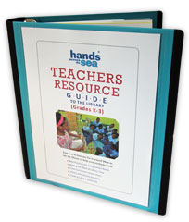
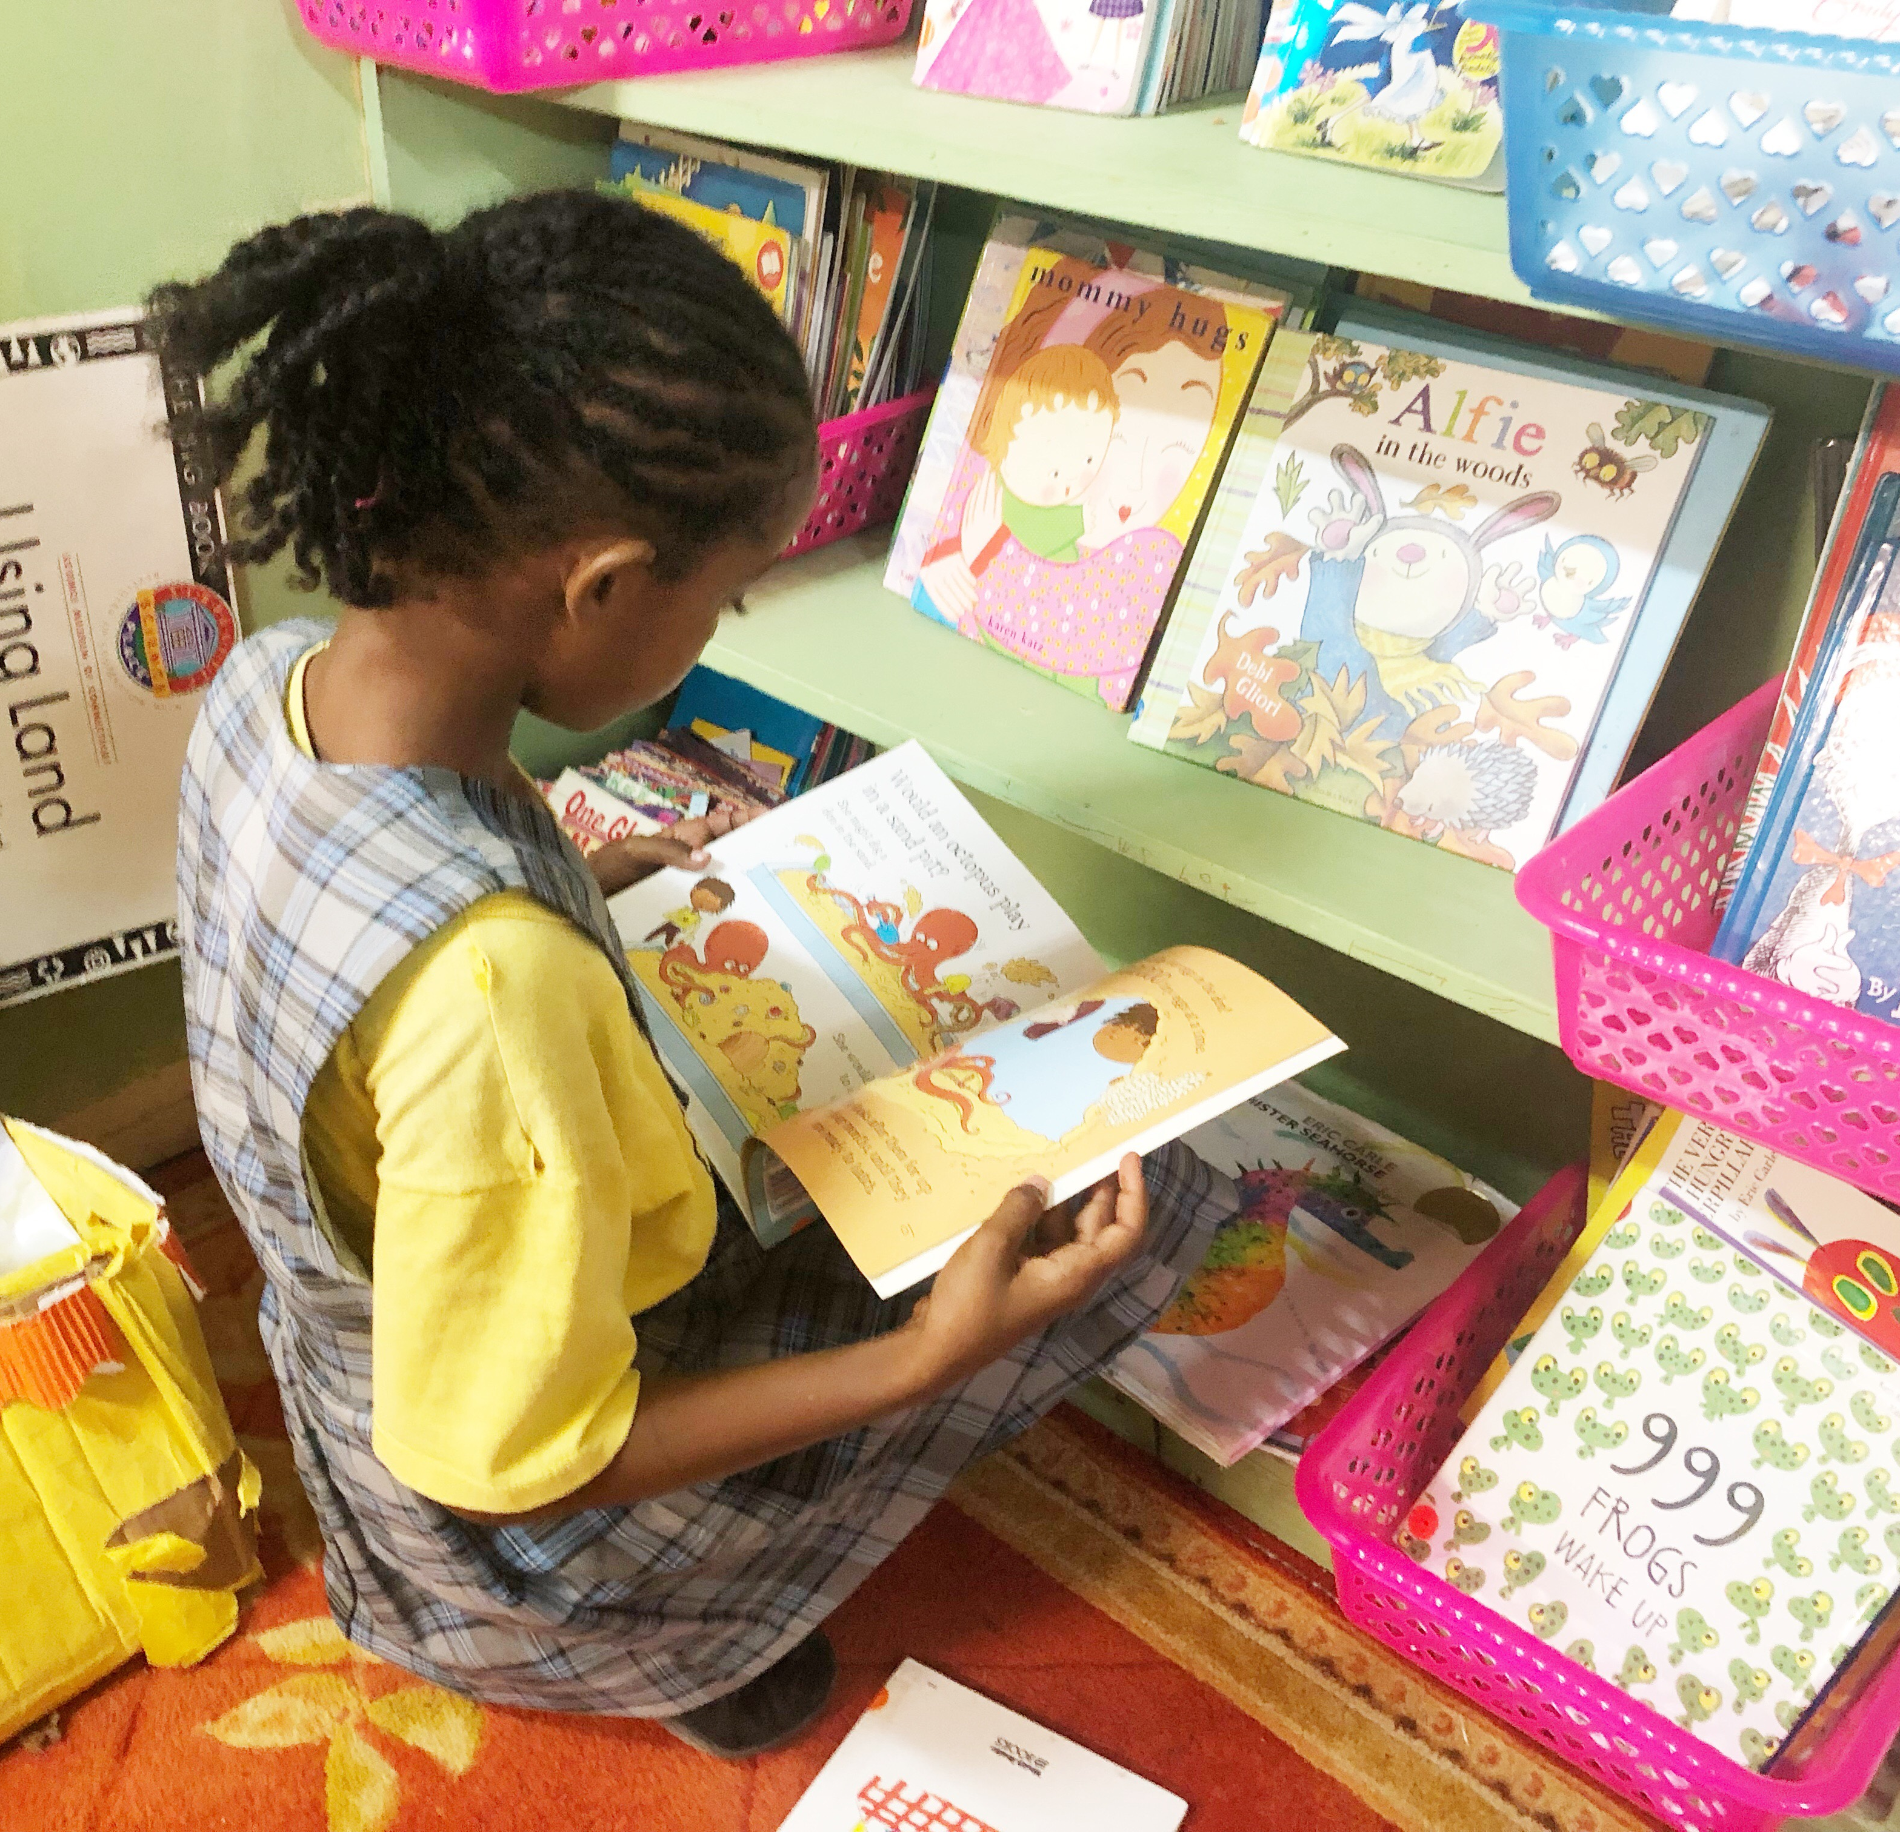
Workshop Goals:
Evidence about pleasure reading habits improving student performance.
Teachers as readers.
The Teachers Resource Guide (TRG) to the Library.
Motivating students to read at school and at home.
Strategies to build a community of lifelong readers.
Notes:
We’ve got a total of 8 workshop goals, 5 on this slide and 3 on the next. My hope is to flesh out exactly how to connect the library at your school with your classroom.
We will start with providing evidence and research by experts, showing how pleasure reading habits improve student performance. When students pick books for themselves and actually have time to read the books they want to read, their reading significantly improves!
Next, we will revisit the idea of teachers as readers and give some practical suggestions that you can implement in your own life to make reading more of a priority for you and for your own family, which in turn is going to transform the way you teach and value reading for your students.
Third, we will explore the Teachers Resource Guide to the Library. The TRG is a publication Hands Across the Sea developed for the purpose of giving teachers the tools they need to start using the library at their schools much more.
We will talk together about ways to motivate students to read at school and at home. As well as investigate strategies to build a community of lifelong readers. Not just as your students in your classroom THIS year, but that they’ll hold on to their love of reading next year and the year after that…into secondary school, college, university—ultimately into adulthood.

Slide 3
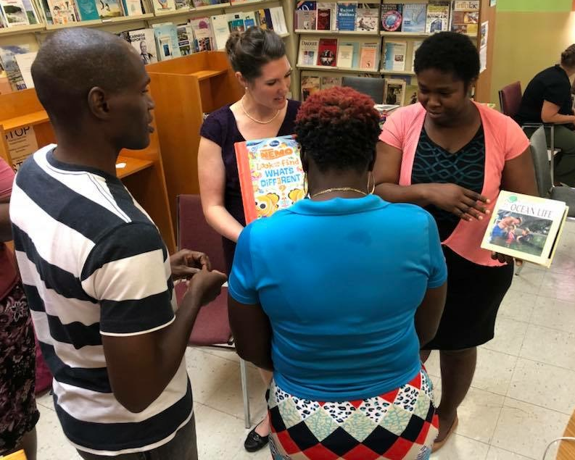
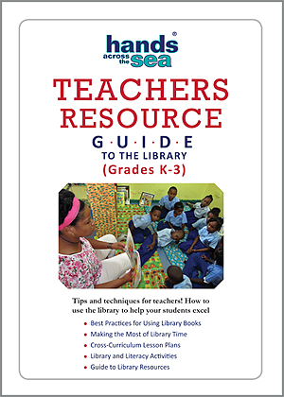
Workshop Goals (continued):
6. How to use books from my library to teach with.
7. How to use the TRG to support my lesson plans in all content areas.
8. Lesson plans and activities that use books from my library to use with my students NOW.
Notes:
We are going to talk about how to use books from the library to teach YOUR curriculum with—not just Language Arts and reading, but…
As number 7 says, how to use the lesson plans in the TRG and ones you create yourself to integrate books from the library into all content areas—science, social studies, math.
And finally, this workshop will provide you the opportunity to actually create a lesson plan and have some activities that use books from your library that you can use with your students tomorrow—as soon as you go back to school.

Slide 4

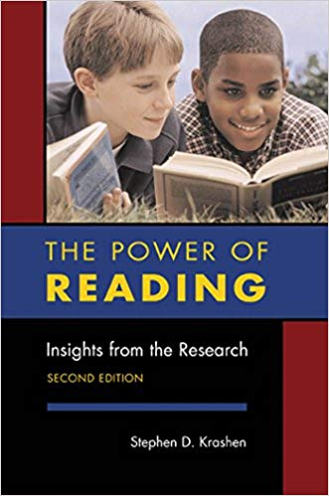
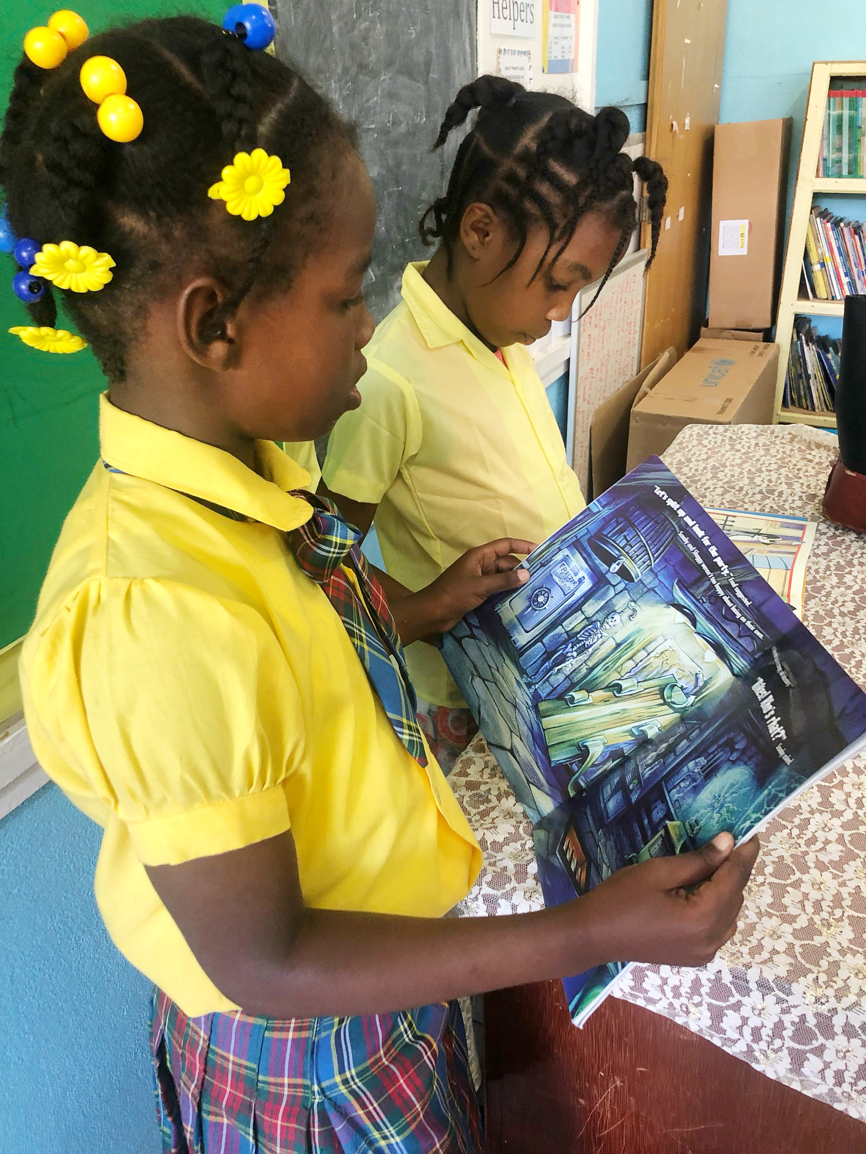
Research shows that pleasure reading habits are the answer to student achievement.
Notes:
So let’s get started with the research. Research shows that pleasure reading habits are THE answer to student achievement. We all want our students to achieve. We want them to pass those standardized reading tests. We want them to do well. So how do we take this research about pleasure reading habits and apply it to our daily classroom routines? That’s our next big question, and we are on our way to it.
Two books that have been instrumental in my research of this topic are: The Power of Reading: Insights from the Research and The Book Whisperer: Awakening the Inner Reader in Every Child. The first book is evidence, case studies, and research compounded to show that the benefits of reading for pleasure is the key to student success. The Book Whisperer is a much more easy, fun read, especially for teachers—and it includes the research, but really works through the “how tos” for us teachers and what a classroom full of readers actually looks like and how we can do it too.

Slide 5
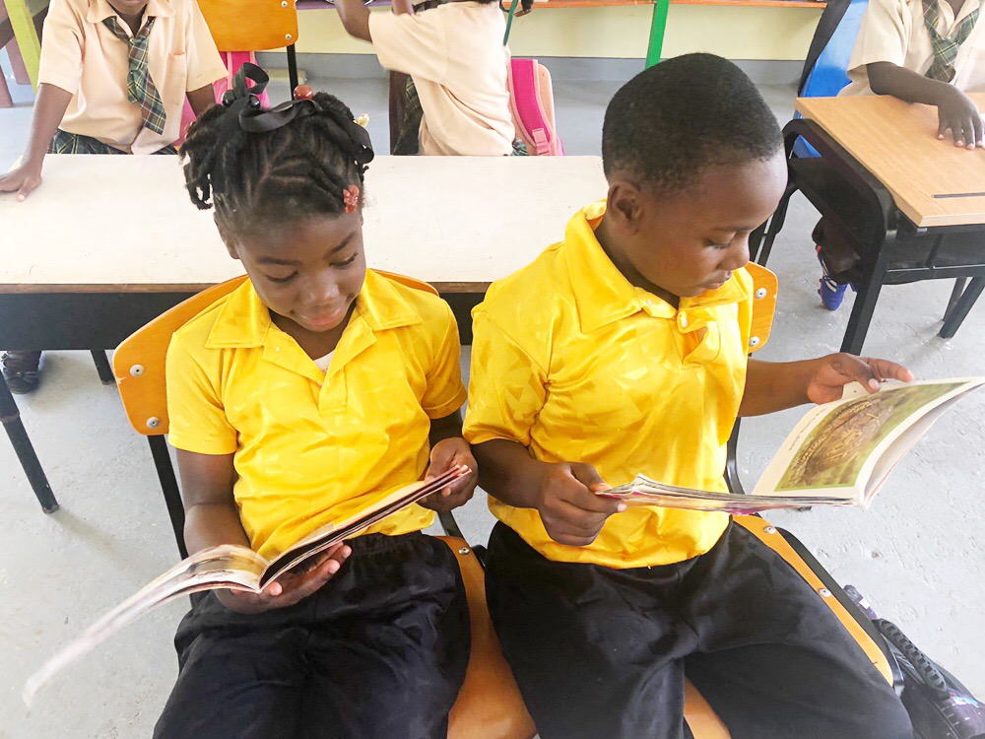
Why pleasure?
Enjoyable
More learning
Motivation
Flow (state of mind when work is somewhat effortless/lose sense of time)
Notes:
Let’s start with what pleasure reading is. Reading for pleasure is reading because you want to.
No book reports, no questions at the end of the chapter.
You get to choose the book you want to read.
You don’t have to finish the book if you don’t like it.
Also called “free, independent reading” (FIR) or “free voluntary reading” (FVR) and sometimes “sustained silent reading” (SSR) by researchers.
Students learn more and are more motivated when they are enjoying the activity.
There is strong evidence that free voluntary reading is very enjoyable.
Flow is the state people reach when they are deeply but effortlessly involved in an activity. Reading is the most frequently mentioned “flow” activity. Think about it. Have you ever been so caught up in what you were reading that you completely lost track of time? That is flow. That is what we are talking about here.
Students’ motivation and interest in reading is higher when they get the opportunity to read in school.
No other classroom activity that teaches reading has shown better results as reading-for-pleasure—not only in terms of reading achievement but also in terms of motivation.

Slide 6
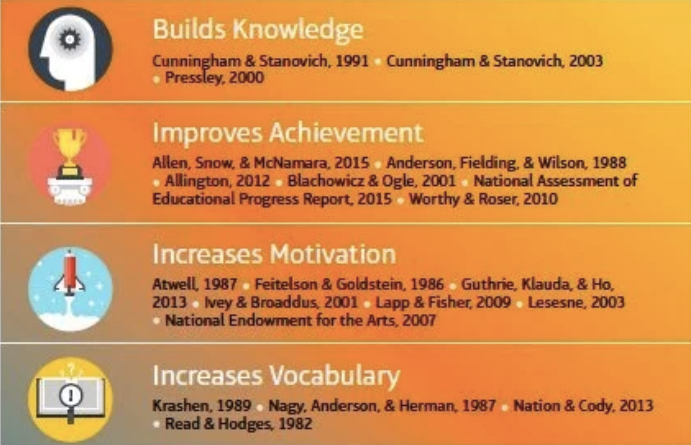
Benefits of Reading for Pleasure
Notes:
The evidence and case studies researchers have found point to all the benefits of reading for pleasure:
It builds background knowledge.
It improves achievement.
It increases motivation.
It increases vocabulary.

Slide 7
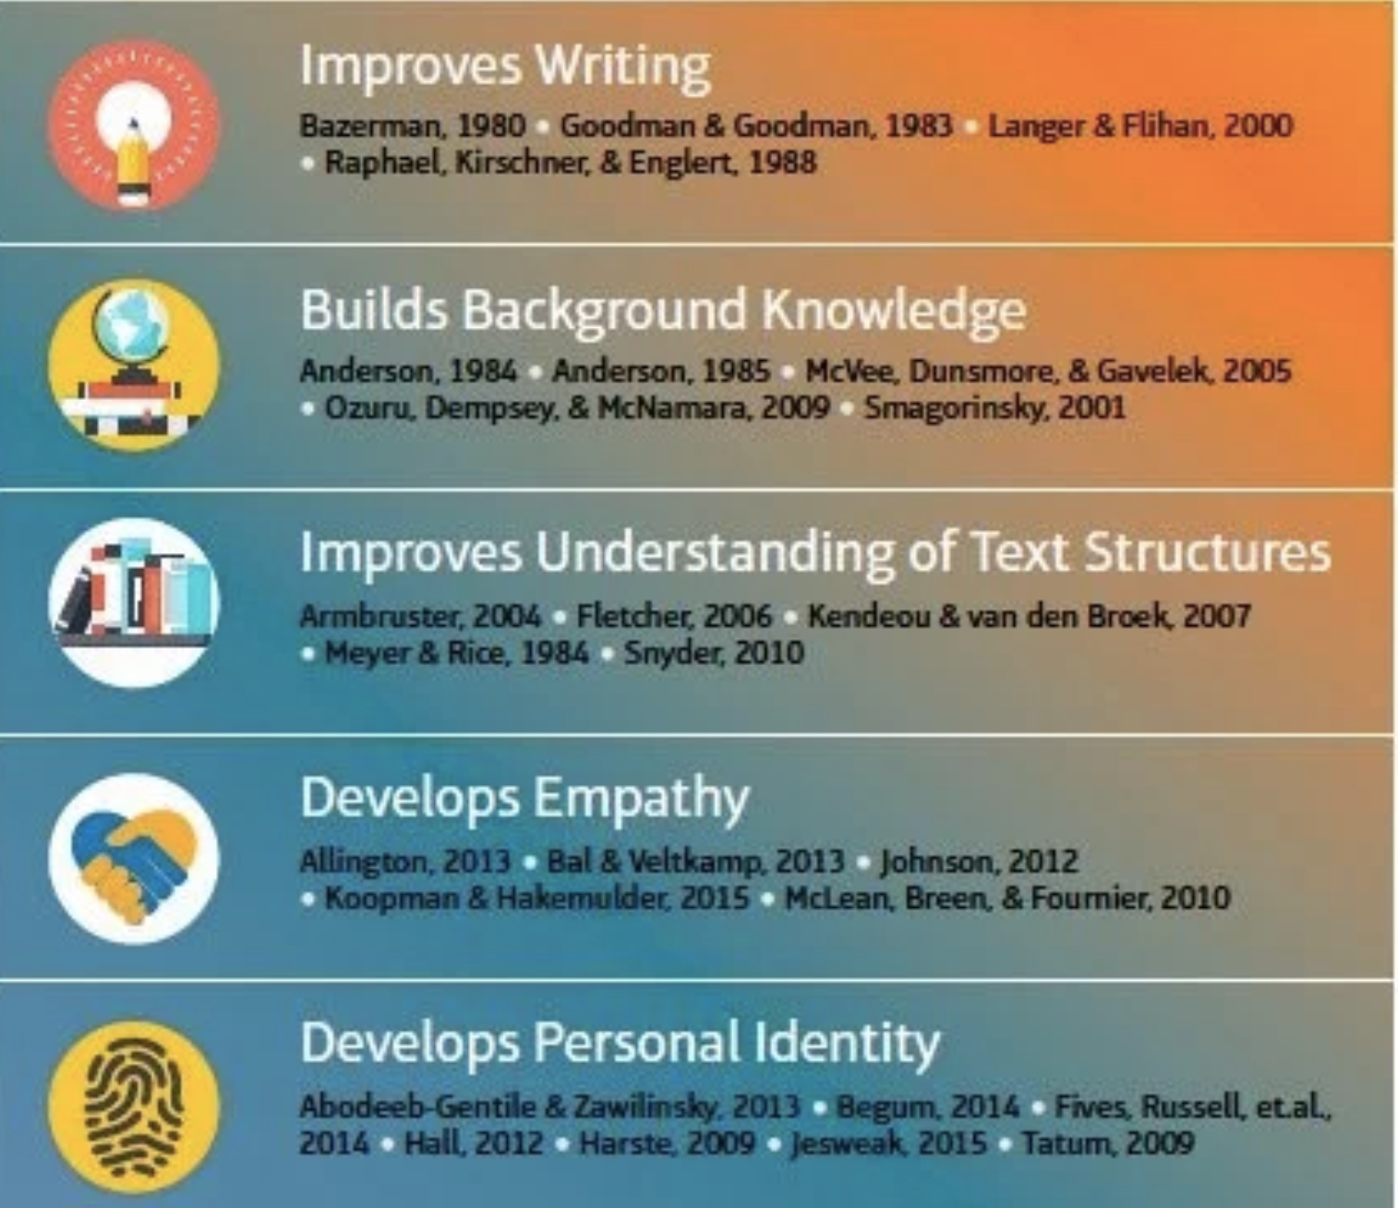
Notes:
It improves writing.
It builds background knowledge.
It improves understand of text structures.
It develops empathy.
It also develops personal identity.
Reading for pleasure builds greater self-confidence in a student as a reader.
Reading for pleasure is the key to becoming a life-long reader and learner. In today’s day and age, students HAVE to be open to learning new things—no matter what industry they choose to pursue.

Slide 8
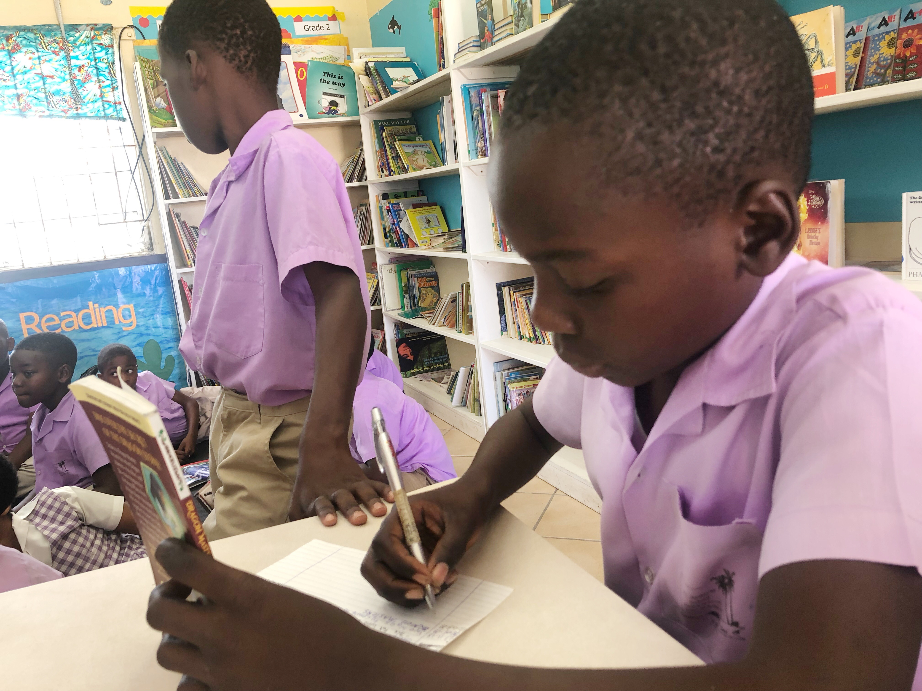
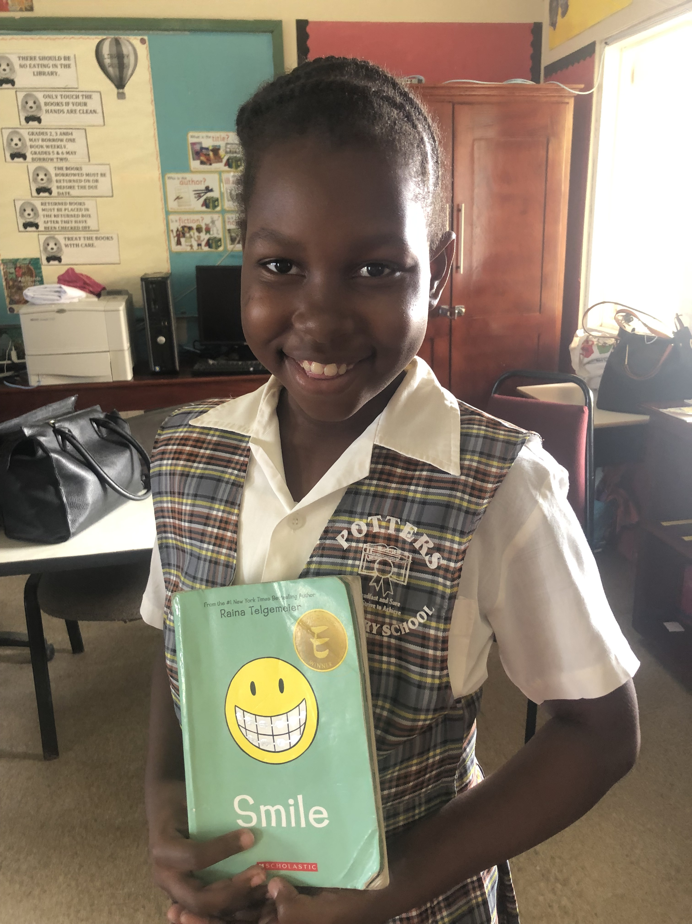
Vocabulary, Grammar, Writing Style, Spelling
“When children read for pleasure, when they get “hooked on books,” they acquire, involuntarily and without conscious effort, nearly all of the so-called “language skills” many people are so concerned about.
“They will become adequate readers, acquire a large vocabulary, develop the ability to understand and use complex grammatical constructions, develop a good writing style, and become good spellers.”
--Dr. Stephen Krashen
Notes:
Well-read people write well because they have subconsciously acquired good writing style.
When children read for pleasure, when they get “hooked on books,” they acquire, involuntarily and without conscious effort, nearly all of the so-called “language skills” many people are so concerned about.
“They will become adequate readers, acquire a large vocabulary, develop the ability to understand and use complex grammatical constructions, develop a good writing style, and become good spellers.”
*Lee and Krashen (1997) proposed that those who read more have less “writing apprehension” because of their superior command of the written language.
Free independent reading exposes students to higher-level vocabulary, proper sentence structure, and syntax; as a result, pleasure readers often wrote at more advanced levels than their peers.

Slide 9
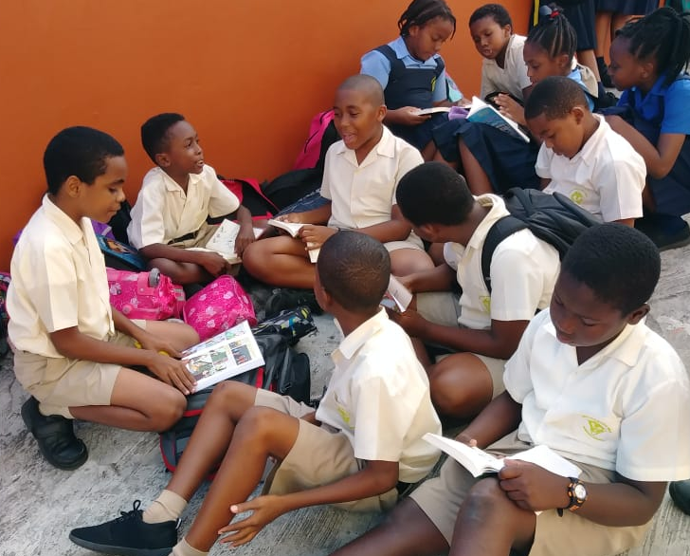
Higher Test scores and academic success
One study done at a low-achieving primary school implemented 30 minutes of pleasure reading a day for all students in every grade level. The report showed that the average student read 20 books and had reading growth of 2.4 years. The school’s total average increased by 8.5 points.
Notes:
Higher test scores and academic success are direct results of allowing students to read books of their choice during the school day.
One study done at a low-achieving primary school implemented 30 minutes of pleasure reading a day for all students in every grade level. The report showed that the average student read 20 books and had reading growth of 2.4 years. The school’s total average increased by 8.5 points.

Slide 10
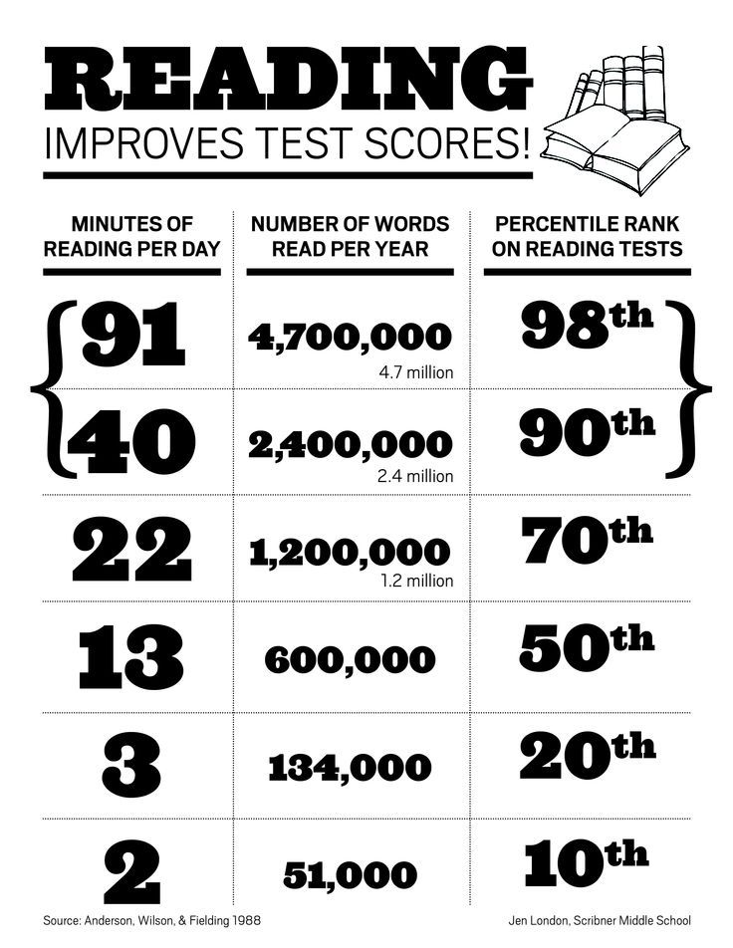
Higher Test Scores – Overall Academic Success
“Research indicates that time spent reading correlates positively with students’ performance on standardized reading tests” (Cunningham & Stanovich, 1998).
Notes:
“Research indicates that time spent reading correlates positively with students’ performance on standardized reading tests (Cunningham & Stanovich, 1998):
You see this chart on the screen with three columns: minutes of reading ber day, number of words read per year, and percentile rank on reading tests.
A student in the twentieth percentile reads books for .7 minutes per day. This adds up to 21,000 words per year.
A student in the eightieth percentile reads books for 14.2 minutes per day. This adds up to 1,146,000 words read per year.
A student in the ninetieth percentile reads for 21.1 minutes per day. This adds up to 1,823,000 words per year.
A student in the ninety-eighth percentile reads for 65.0 minutes per day. This adds up to 4,358,000 words per year.
This study was done with Grade 6 students. As you can see, the volume of independent, silent reading that students do in school is significantly related to gains in reading achievement. So immediately the wheels start turning in my head about what we can do as teachers about this. Because if you are anything like me, I want my students in the 98th and 90th percentile, so that means I have got to get them reading between 40 to 91 minutes a day to make that happen.

Slide 11

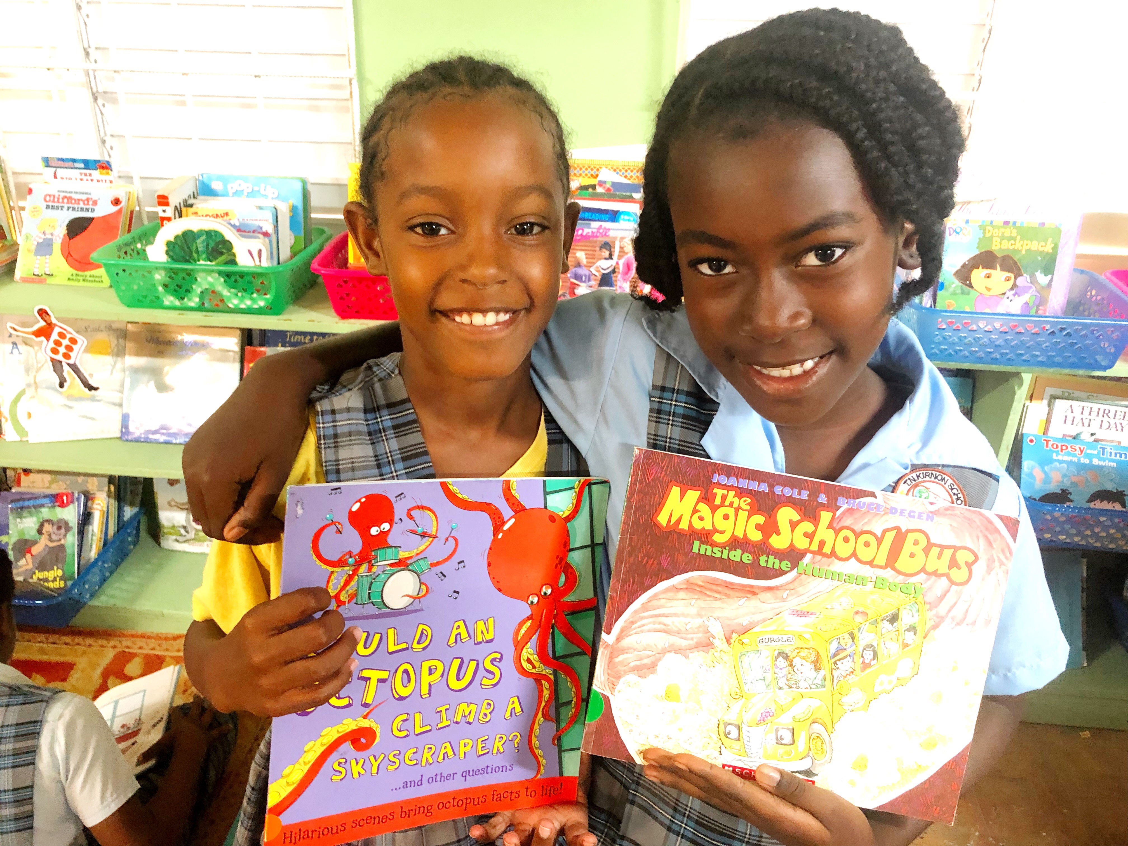
Our goal is to develop life-long readers!
QUESTION: How do we motivate our students to WANT to read for themselves?
ANSWER: Give them a chance to actually read at school and get into a home-run book that they will want to take home and find out what happens next!
Notes:
Our goal as teachers is to develop life-long readers.
The QUESTION is: How do we motivate our students to WANT to read for themselves?
The ANSWER is simple: Give them a chance to actually read at school and get into a home-run book that they will want to take home and find out what happens next!
*“Reading is more than a number. It is a civic responsibility—one that should live in and outside the classroom.” (Myers, Miller 181)
“If we create a passion for reading within our students, they will be able to carry on the kind of inquiry that is needed to function in our democracy.” (Miller 180)
“Our students are shortchanged if we fail to teach reading beyond the narrow definition of a test score.” (Miller 180)

Slide 12
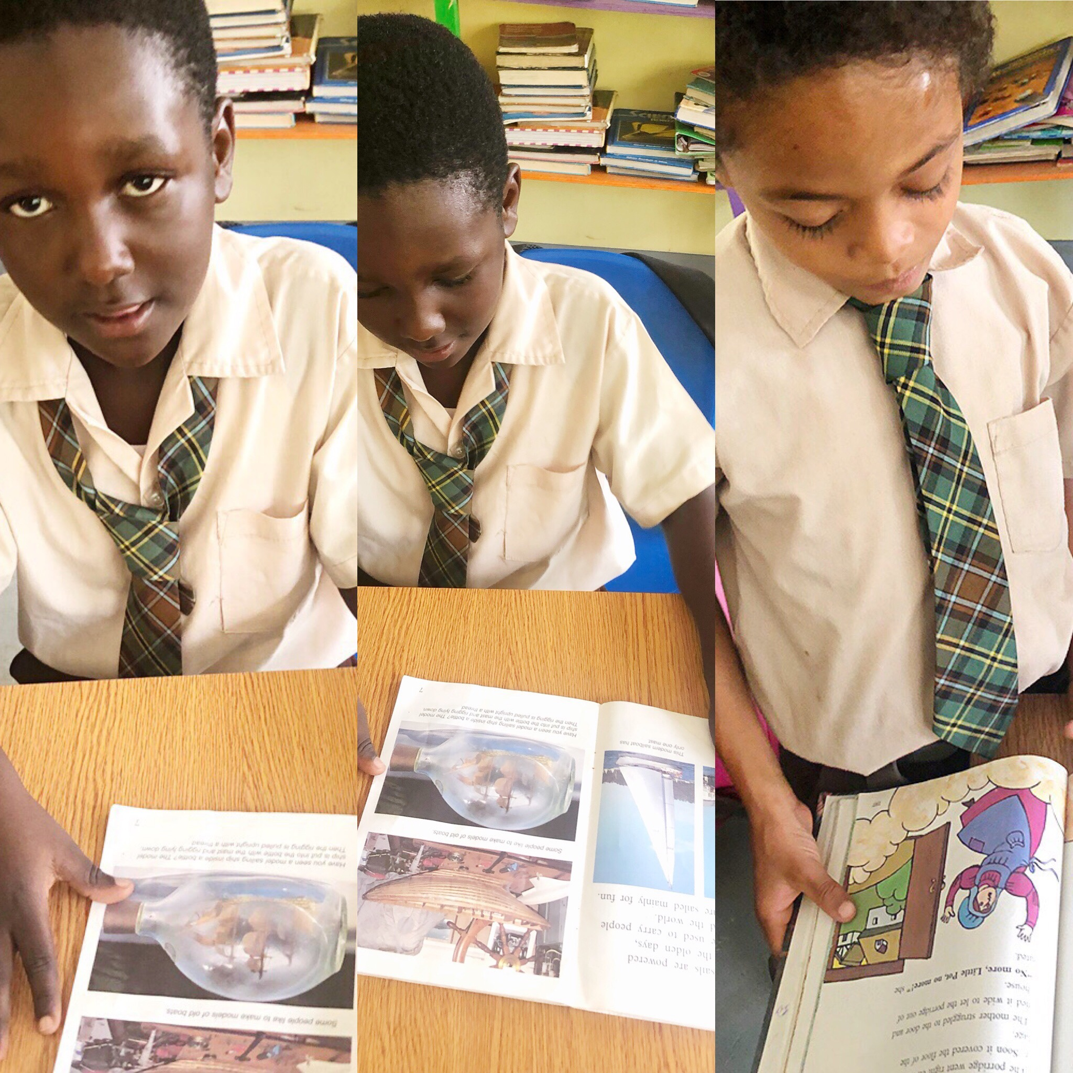

Requires Daily Commitment
Ensuring our students read every day at school provides them opportunities to fall in love with books and develop stamina for reading.
Daily pleasure reading IN SCHOOL builds students’ capacity for reading OUTSIDE of school—which is what we want our students to do!
Notes:
This requires a daily commitment on all of our parts.
Ensuring our students read every day at school provides them opportunities to fall in love with books and develop stamina for reading.
Daily pleasure reading IN SCHOOL builds students’ capacity for reading OUTSIDE of school—which is what we want our students to do!
*The more students practice, the more they enjoy and develop confidence in reading and the more likely they are to read in their free time.
We cannot tell children they need to read more and refuse to offer any time for them to read during the school day.
References: Miller, D. 2014. Reading in the Wild, San Francisco: Jossey-Bass.

Slide 13
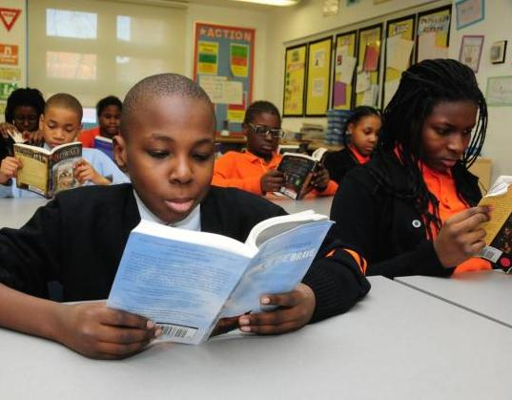
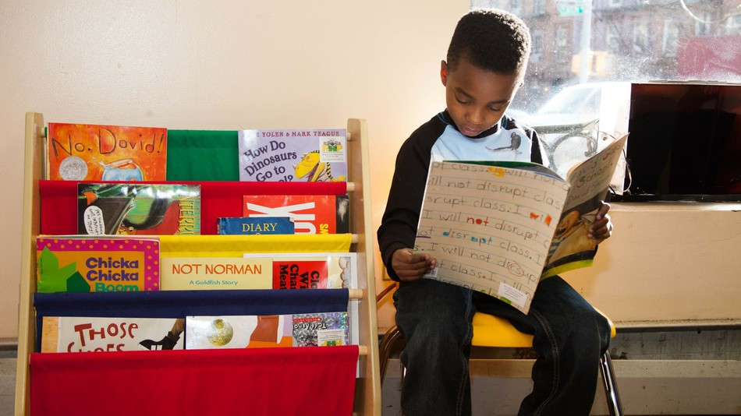
Allow more time for students to pleasure read.
School-wide DEAR time – 15 minutes
Extend DEAR time to 30 minutes (if possible)
Take students to the school library weekly.
Notes:
So let’s brainstorm some ideas here. We need to allow more time for students to pleasure read.
We know that ”students are more likely to read a book at home that they have started reading at school.” (Miller, 2009, 51)
*We can establish school-wide DEAR time (Dear stands for drop everything and read) for at least 15 minutes a day. We can work together as staff to ensure that all classes at our schools are being held accountable to offer this time every day to their students.
We can also consider extending DEAR time to 30 minutes (if possible) to get even more reading time in for our students.
As teachers, taking our students to the school library weekly is a must. They need to be aware of the books available to them to read.

Slide 14
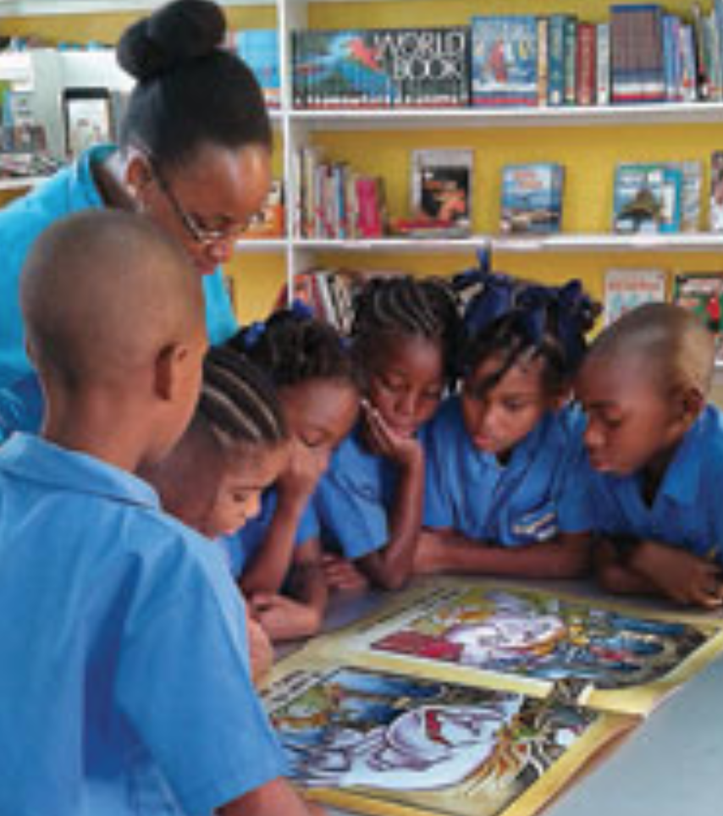
Allow more time for students to pleasure read.
Bring books from the library to the classroom for students to browse and choose from.
Require students to check in and check out books weekly; take books home and bring them back to school every day to read.
Model pleasure reading yourself (as the teacher) by bringing a book to school and reading it during DEAR time too.
Notes:
You as the teacher can help by bringing books from the library to the classroom for students to browse and choose from too.
Require students to check in and check out books weekly; take books home and bring them back to school every day to read.
Model pleasure reading yourself (as the teacher) by bringing a book to school and reading it during DEAR time too. What about a teachers as readers book club once a month during the lunch break? Every teacher brings the book they have read or are reading, and that lunch conversation is specifically dedicated to conversations about the books you are reading. Tell your students about the club. Students are amazed when they find out their teachers enjoy reading and it gives them permission to enjoy reading and talking about books too! Who knows, they may get the idea to start their own book club outside of school…this is huge!

Slide 15
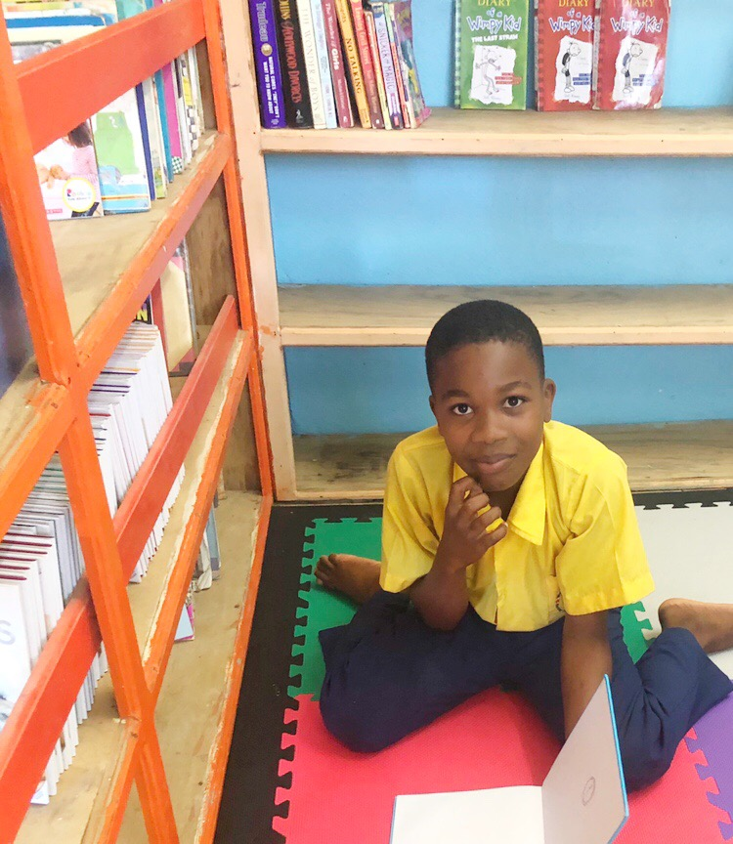
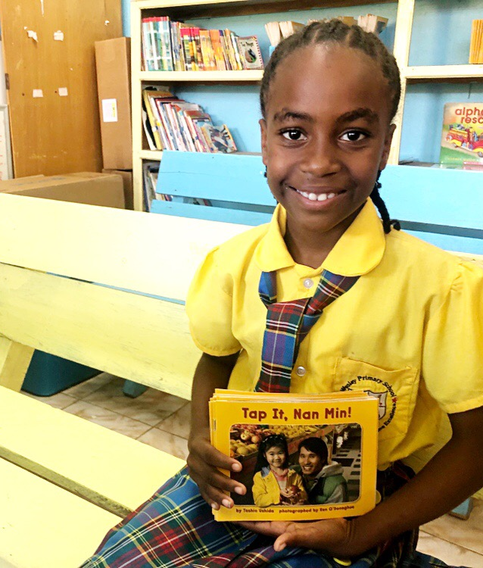
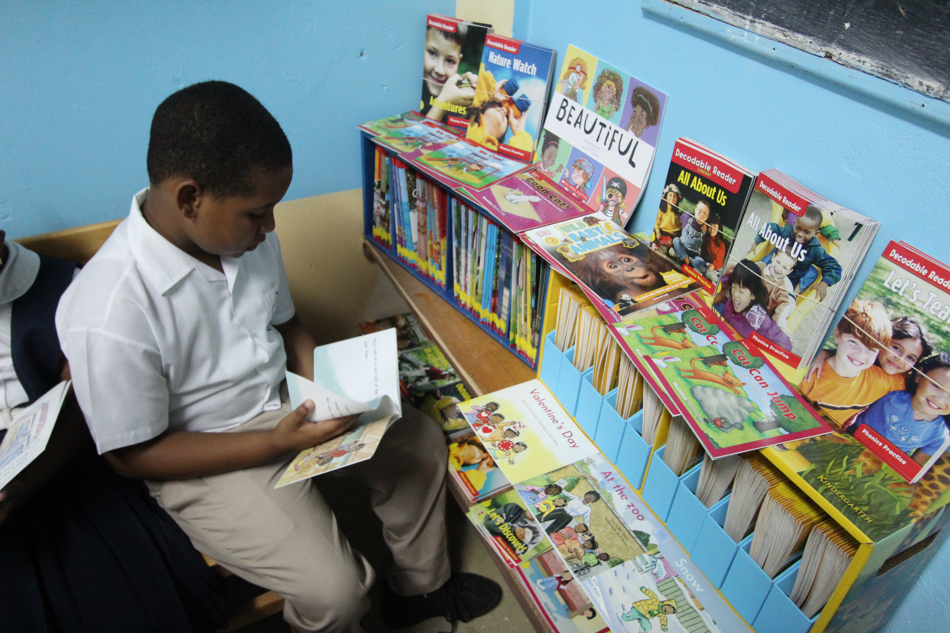
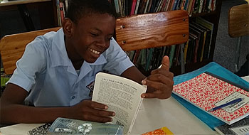
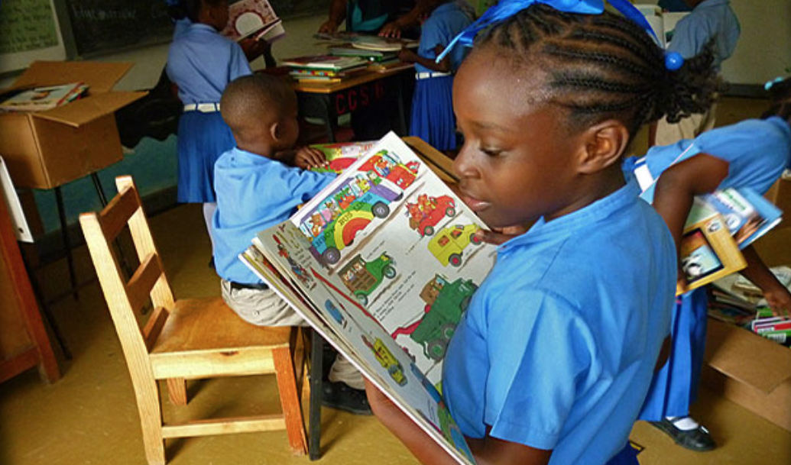
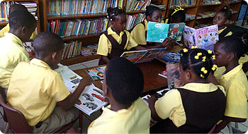
Practical Ideas: Students can pull out a book during…
Classroom interruptions.
Bell ringers and warm-ups.
When students are done.
In between times (sports days, awards days, assemblies) – how to keep your students quiet while they wait.
Library Time (waiting for other students).
Notes:
Other practical ideas include teaching your students classroom norms and routines that can be established at the very beginning of the year that you follow through on throughout the terms ahead. Students can pull out a book during classroom interruptions. How many of us have had our lessons interrupted for some reason or another? You have to step away. What does your class do while they are waiting for the lesson to resume?
*What about bell ringers and warm ups? When students get to school early and they are waiting on their teacher to arrive? What if the norm in your class was to train your students to have their books out, reading around the classroom or the courtyard or sitting against the wall in the hallways or at their desks before school begins?
*What about when students are done with an assignment and they are waiting for the rest of the class to finish too? Pull out the book and read. You don’t have to create any extra assignments to keep them busy. They’re getting in those 40-91 minutes of reading in that they need to succeed.
In between times like sports days, awards days, assemblies—how often do we complain that we can’t seem to keep our students quiet while they are waiting for something to begin? The solution may be to bring a book with them and read it until the event begins and they put it away.
*And obviously weekly Library Time is a great place for reading too. They’ve checked out their book already, they’re waiting on the other students to check out theirs. They’re sitting on the floor reading their book while they are waiting for the others.
*Pleasure reading is NOT something extra. It is the number one activity that will strengthen our students as readers and develop all of those skills they need that we saw from the research at the beginning. *If you haven’t been protecting time every single day to allow your students to pleasure read in your classroom, my challenge to you is-–what can you do to make this happen right now, this year, this term?

